Slide 1



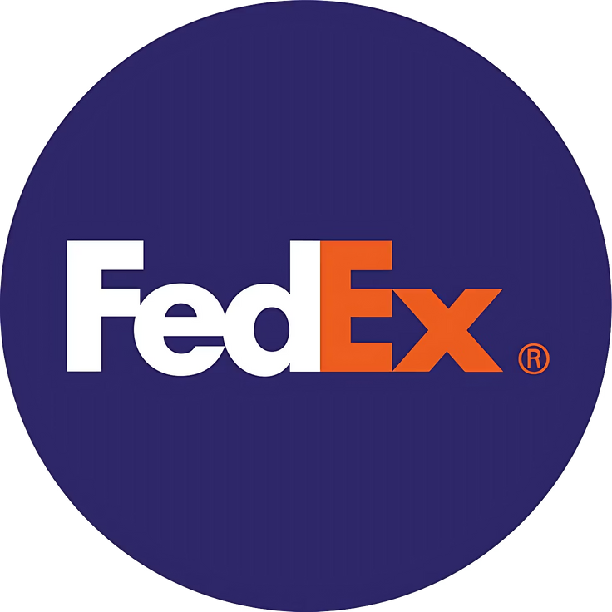
FedEx LOGISTICS EDA
By:
NIKET TALIKOTI

Slide 2


Project Summary –
•This project focuses on performing Exploratory Data Analysis (EDA) on a FedEx logistics dataset, aiming to uncover insights and optimize logistics processes. The dataset consists of 10,324 entries and 33 columns, containing detailed shipment, product, and logistics information such as project codes, shipment modes, product descriptions, freight costs, and delivery dates. Key columns include shipment-related details like Shipment Mode, Scheduled Delivery Date, and Freight Cost (USD), along with product-specific information such as Brand, Dosage, and Item Description.
•EDA steps in this project include cleaning the data by handling missing values, converting incorrect data types, and managing outliers. Data visualization techniques are applied to identify patterns and correlations between different attributes, especially focusing on shipment costs, product types, and delivery performance. Descriptive statistics are used to summarize the key metrics, while deeper exploratory analysis helps identify areas for improvement in the logistics and supply chain process. The project uses tools like Pandas for data manipulation, Matplotlib and Seaborn for visualization, and Jupyter Notebook for analysis documentation. Insights gained from the analysis can potentially lead to improved decision-making and cost optimization in logistics operations.

Slide 3
Problem Statement
The problem statement for this project is to perform Exploratory Data Analysis (EDA) on a FedEx logistics dataset to identify patterns, trends, and insights that can optimize logistics processes and improve decision-making. The dataset contains information on over 10,000 shipments, including shipment details, product descriptions, freight costs, delivery dates, and more. The goal is to analyze the relationships between various attributes such as shipment modes, delivery performance, product types, and associated costs. The project aims to:
Clean the dataset by handling missing values, correcting data types, and addressing any inconsistencies.
2. Explore and visualize key metrics such as shipment costs, delivery times, and product characteristics.
3. Identify factors that impact freight costs, delivery delays, and shipment efficiency.
4. Provide actionable insights and recommendations for optimizing FedEx’s logistics operations, such as cost reduction strategies, improvements in shipment scheduling, and enhancements in product categorization.
By conducting thorough EDA, the project seeks to uncover valuable insights that can help FedEx enhance their logistics strategy, streamline operations, and ultimately deliver more efficient and cost-effective services to their clients. its clients.

Slide 4
Business Objective
The business objective of this project is to leverage data-driven insights to optimize the logistics operations of FedEx, focusing on improving efficiency, reducing costs, and enhancing customer satisfaction. By performing Exploratory Data Analysis (EDA) on the logistics dataset, the aim is to:
Optimize Freight Costs: Identify patterns and factors that influence freight costs to develop strategies for reducing shipping expenses while maintaining service quality.
2. Enhance Delivery Efficiency: Analyze delivery timelines and factors contributing to delays, enabling improvements in shipment scheduling, route optimization, and resource allocation to ensure timely deliveries.
3. Improve Product Categorization: Explore how product classifications and descriptions impact logistics processes, leading to better inventory management and streamlined handling of shipments.
4. Identify Operational Bottlenecks: Pinpoint areas of inefficiency or inconsistencies in the logistics chain, allowing for process improvements that increase operational productivity.
5. Support Data-Driven Decision Making: Provide actionable insights to decision-makers, enabling them to make informed choices that optimize logistics operations, reduce costs, and improve overall service quality.
Ultimately, the business objective is to transform data into valuable insights that lead to more cost-effective, efficient, and reliable logistics solutions, benefiting both FedEx and its clients.

Slide 5
What did you know about your dataset
The dataset is a detailed FedEx logistics dataset with 10,324 entries and 33 columns. It contains information on shipments, product details, and logistics operations. The data includes both numerical and categorical types, covering shipment processes, product attributes, and costs.
Key Features:
Shipment Details: - Columns like `Project Code`, `PQ #`, `PO / SO #`, and `ASN/DN #` provide shipment tracking IDs. - Details about shipment mode (e.g., air, sea, land) and delivery dates (`Scheduled Delivery Date`, `Delivered to Client Date`) are included.
2. Product Information: - Data on product categories (`Product Group`, `Brand`) and descriptions (`Item Description`, `Dosage`). - Information on product size and quantity (`Weight (Kilograms)`, `Unit of Measure (Per Pack)`).
3. Costs: - Shipping costs (`Freight Cost (USD)`, `Line Item Insurance (USD)`). - Pricing details (`Pack Price`, `Unit Price`, `Line Item Value`).
4. Missing Data: - Some columns, like `Shipment Mode`, `Dosage`, `Insurance`, and `Weight`, have missing values that need cleaning.
5. Data Types: - Mix of numerical (`Weight`, `Freight Cost`), categorical (`Country`, `Vendor`), and date-based data (`Scheduled Delivery Date`). This dataset is essential for analyzing trends, improving processes, and nding insights for better logistics operations.
https://drive.google.com/file/d/1Mx0PEFsVxKikhcCcC0Okc8KwW8SC4BYt/view?usp=sharing

Slide 6
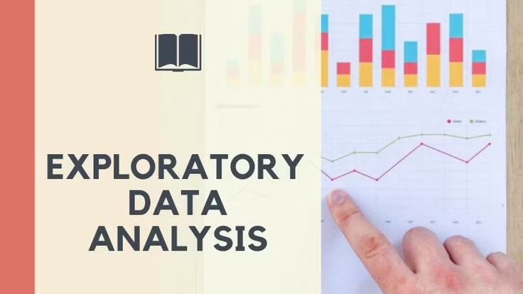

Slide 7
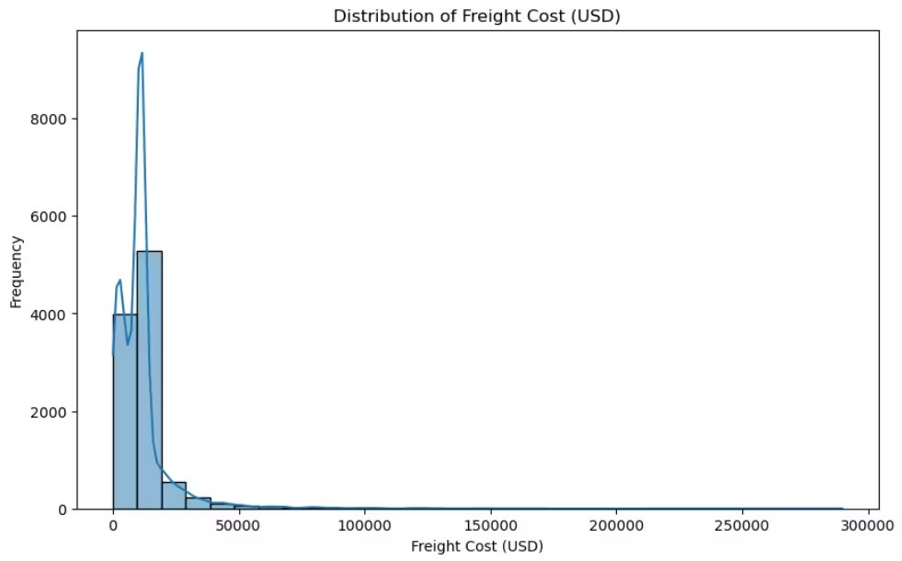
Distribution of Freight Cost(USD)
The distribution of freight costs reveals a strong right skew, indicating that most shipments incur relatively low costs, typically under $30,000. However, a small number of shipments exhibit extremely high freight costs, reaching up to $290,000. These outliers significantly impact the overall cost structure and may point to inefficiencies or special handling requirements. Identifying the root causes of these high-cost shipments—such as mode of transport, distance, or urgency— could help optimize logistics operations. By focusing on these anomalies, the company has an opportunity to reduce overall freight expenses and improve supply chain efficiency without compromising delivery performance.

Slide 8
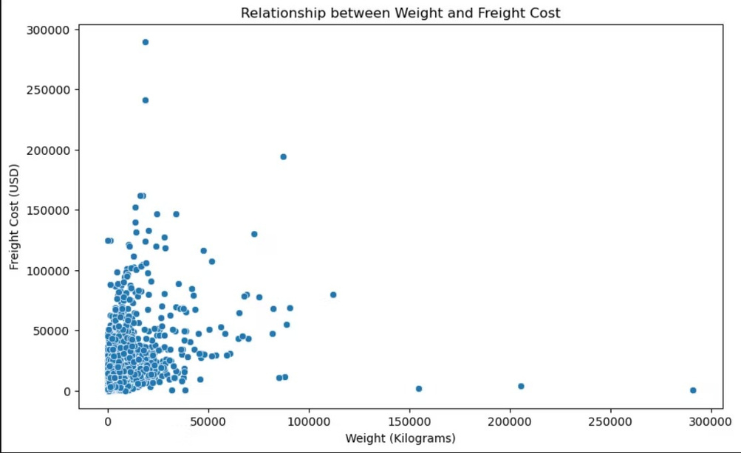
Relationship between Weight and Freight Cost
The scatter plot reveals a weak positive relationship between shipment weight and freight cost. While heavier shipments generally cost more, there is signi cant variability in freight costs for similar weights, especially in the lower weight range. This suggests that factors other than weight, such as shipment urgency, destination, or mode of transport, play a major role in determining cost. A noticeable number of outliers also exist where low- or medium-weight shipments incur disproportionately high costs. These should be further analyzed to identify cost-saving opportunities and improve logistics ef ciency.

Slide 9
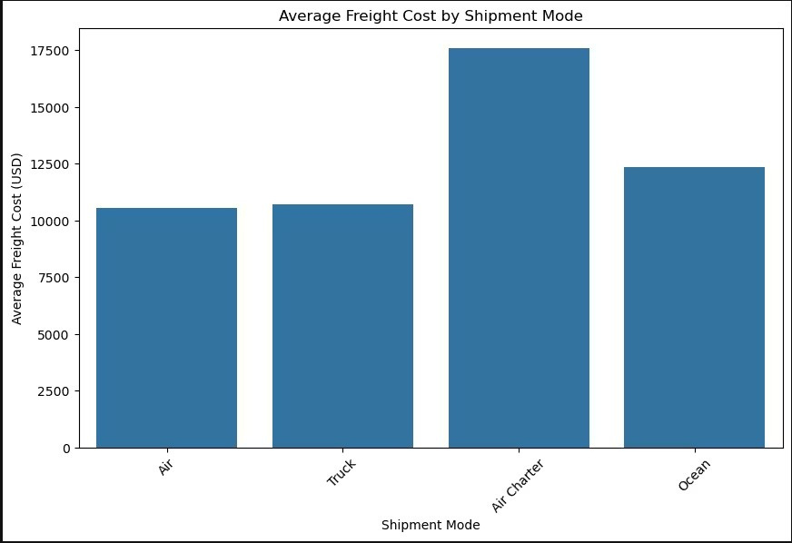
Shipment Mode vs. Freight Cost
The analysis shows that Air Charter has the highest average freight cost among all shipment modes, signi cantly surpassing Air, Truck, and Ocean. This mode is typically used for urgent or high-value shipments, justifying the premium price. In contrast, Air and Truck shipments have similar average costs, while Ocean freight, although slower, tends to be more economical for large and non-urgent shipments. These ndings highlight an opportunity to optimize shipment mode selection based on urgency, cost, and shipment characteristics, potentially reducing logistics expenses without compromising service quality.

Slide 10
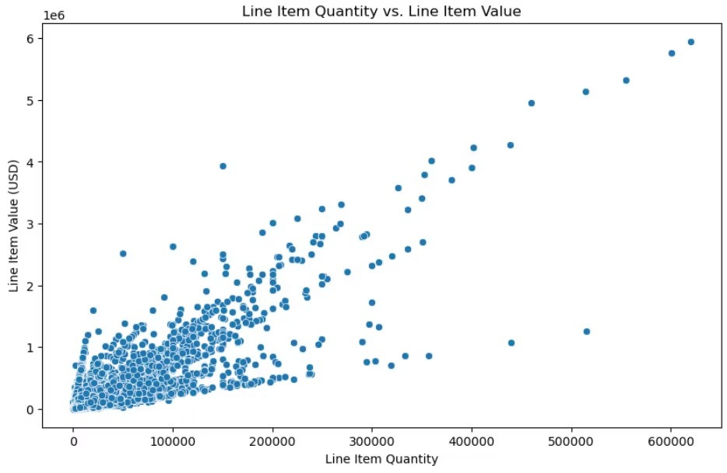
Line Item Quantity vs. Line Item Value
This scatter plot reveals a strong positive correlation between line item quantity and line item value, indicating that as the number of items increases, the total value also tends to rise. The data points form a consistent upward trend, although some outliers exist with high values despite relatively low quantities, which could be attributed to high-value items. This insight suggests that volume plays a critical role in overall shipment value, and monitoring these relationships can help in forecasting revenue and identifying pricing anomalies or high-margin products for strategic planning and inventory control.

Slide 11
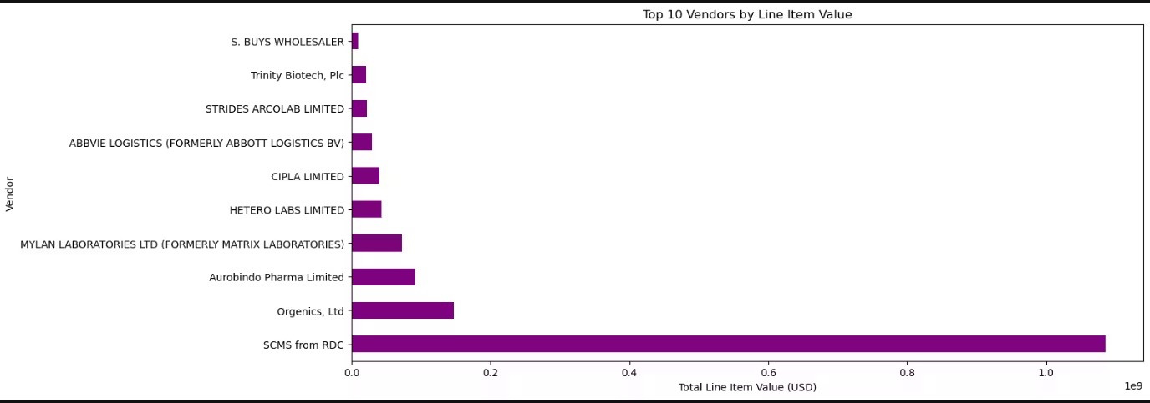
Total Line Item Value by Vendor
The chart highlights the top vendors based on total line item value. SCMS from RDC overwhelmingly leads, contributing over $1 billion, signi cantly outpacing all other suppliers. This dominance suggests a heavy reliance on SCMS, which could pose supply chain risks if not diversi ed. Other notable vendors like Organics Ltd. and Aurobindo Pharma show moderate contributions, while the remaining vendors contribute relatively smaller shares. The data emphasizes the importance of vendor performance monitoring and may prompt strategic evaluations to balance supply volume, manage risks, and enhance procurement ef ciency through more diversi ed sourcing.

Slide 12
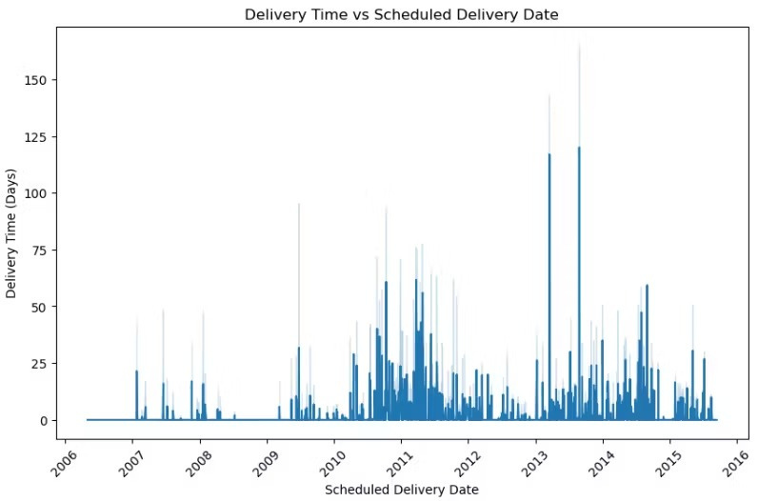
Delivery Time vs Scheduled Delivery Date
This chart shows delivery time trends from 2006 to 2016. While most deliveries occur within 30 days, there are notable spikes, particularly between 2010 and 2014, where delivery times occasionally exceeded 100 days. These delays may indicate disruptions such as logistical challenges, supplier inef ciencies, or geopolitical factors. After 2014, a decline in extreme delays suggests improved supply chain performance. Monitoring delivery time over time is crucial for identifying inef ciencies, evaluating vendor reliability, and improving service levels. Continuous improvement in logistics and planning can help stabilize delivery times and reduce costly delays.

Slide 13
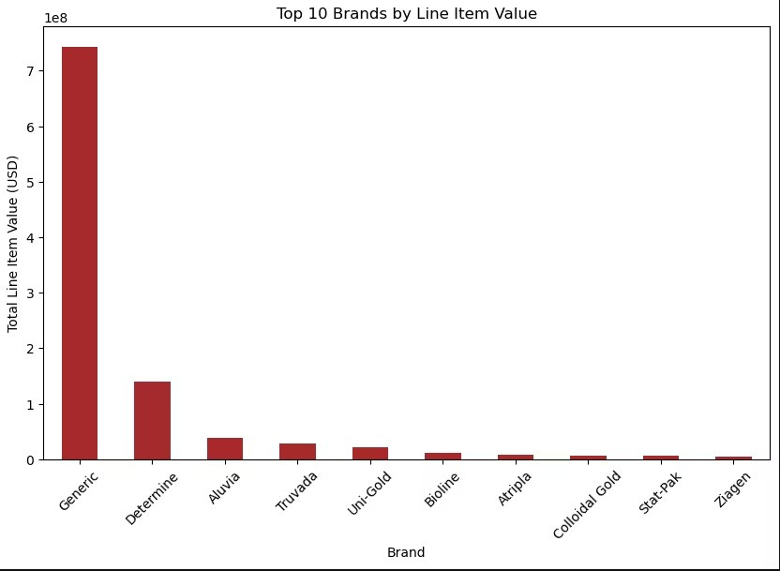
Top 10 Brands by Line Item Value
The data reveals that Generic products dominate procurement, contributing over $700 million in line item value—signi cantly more than any branded counterpart. This highlights a clear preference for cost-effective, non-branded alternatives, likely driven by budget optimization. The next highest brand, Determine, contributes around $150 million, followed by Aluvia and Truvada with markedly smaller shares. The remaining brands, including Atripla and Ziagen, show minimal nancial impact. This strong reliance on generics suggests strategic procurement aimed at maximizing treatment coverage while minimizing cost. It may also re ect the widespread availability and effectiveness of generic versions for essential medications.

Slide 14
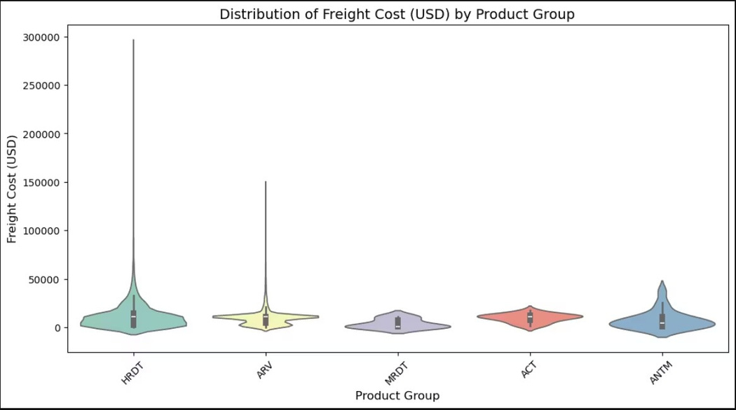
Distribution of Freight Cost (USD) by Product Group
Freight cost distribution varies signi cantly across product groups. HRDT exhibits the widest spread and highest outliers, with some shipments exceeding $300,000, indicating occasional high-cost logistical challenges. ARV also shows a wide range but is slightly more concentrated around lower costs. MRDT has the most compact distribution, suggesting stable and predictable freight expenses. ACT and ANTM have moderate ranges, though ANTM has more high-cost outliers. These patterns may re ect differences in shipment size, weight, urgency, or route complexity. Monitoring HRDT and ARV logistics could uncover opportunities to optimize freight expenditures and reduce extreme shipping costs.

Slide 15
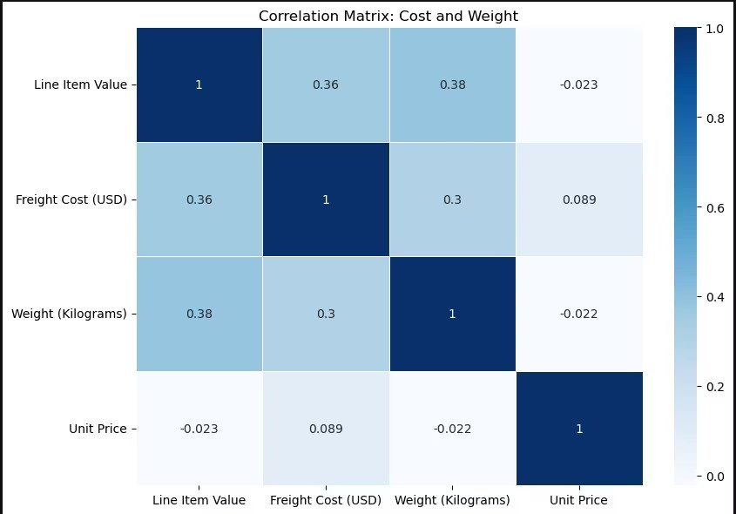
Correlation Between Cost Metrics
The correlation matrix reveals that line item value and freight cost are moderately correlated with weight (0.38 and 0.30, respectively), suggesting that heavier items typically incur higher costs. A moderate correlation (0.36) also exists between line item value and freight cost. However, unit price shows virtually no correlation with other variables, indicating that per-unit cost does not signi cantly in uence total value, weight, or freight charges. This insight implies that shipment planning should prioritize weight management to control costs, while unit price alone is not a reliable driver of total logistics expenses.

Slide 16
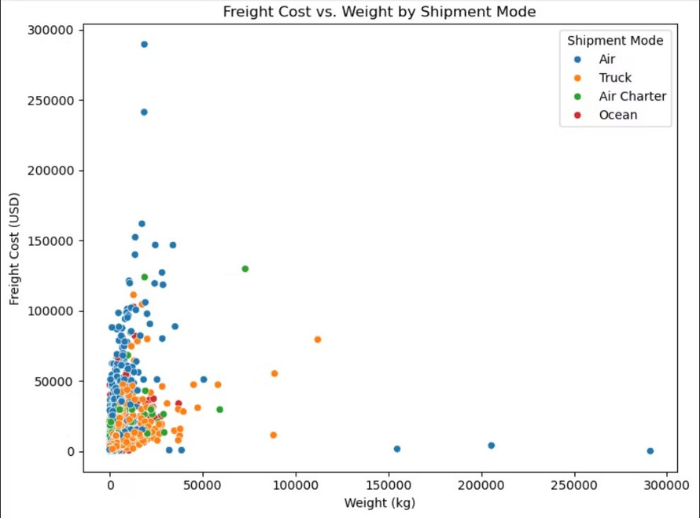
Freight Cost vs. Weight
This scatter plot shows the relationship between freight cost and shipment weight across different shipment modes. Air shipments dominate the higher cost range, even for lower weights, highlighting their premium nature. In contrast, truck and ocean shipments handle heavier weights with comparatively lower costs, making them more economical for bulk logistics. Air Charter appears in a limited range but also incurs high costs per kilogram. Overall, shipment mode signi cantly in uences cost ef ciency, and selecting truck or ocean for heavier loads can substantially reduce freight expenses compared to air-based options.

Slide 17
5. Solution to Business Objective
Strategic Actions for Procurement & Logistics Optimization
Focus on High-Value Vendors & Brands
2. Improve Delivery Timelines
3. Reduce Freight Costs
4. Strengthen Inventory Planning
5. Monitor with Dashboards
Business Impact •Lower costs •Reliable delivery •Stronger inventory health •Better planning & supplier leverage

Slide 18
Conclusion
The analysis reveals key opportunities to improve procurement and supply chain performance through smarter vendor management, shipment planning, and cost control.
•Top vendors and brands account for most of the spend—targeting them can drive bulk savings.
•HRDT and ARV show high freight cost variability, suggesting inef ciencies.
•Heavy use of Air shipments, especially for lighter weights, leads to in ated costs—mode shifts to
Truck or Ocean can reduce this.
Key Actions:
•Optimize contracts with high-spend suppliers
•Improve delivery performance and inventory planning
•Control freight costs through consolidation and better shipment modes
•Leverage data to guide strategic procurement decisions These steps will lead to lower costs, stronger vendor performance, and greater operational efciency.

Slide 19


